Slide 1
Linear Regression
Some materials are taken from course of Andrew Ng and online materials

Slide 2
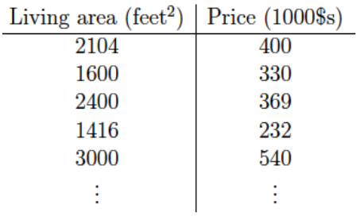
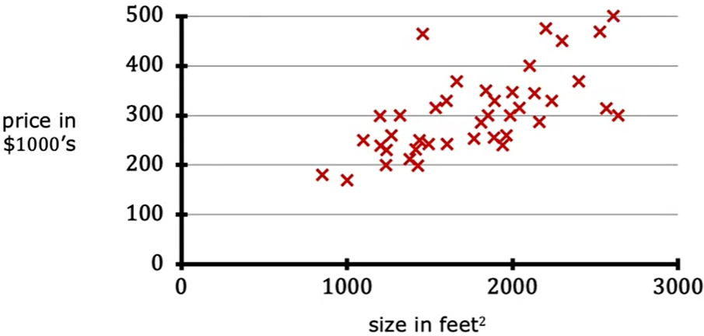
Living area and price of houses in a city:
Given this dataset, we want to predict the price of houses of other sizes in the city.
In other words, we want the price represented as a function of the size.

Slide 3
Living area and price of houses in a city:
We will consider this as a training set composed of feature (Living area size) and target/label variable (Price) -> Supervised Learning Problem.
The target variable we are trying to predict is continuous -> Regression Problem

Slide 4
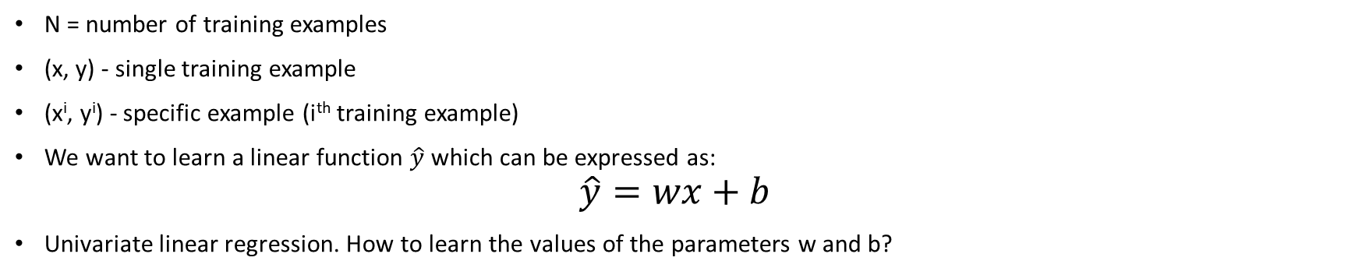
Living area and price of houses in a city:
N = number of training examples
(x, y) - single training example
(x^{i}, y^{i}) - specific example (i^{th} training example)
We want to learn a linear function $\hat{y}$ which can be expressed as:
$$\hat{y}=wx+b$$
Univariate linear regression. How to learn the values of the parameters w and b?

Slide 5
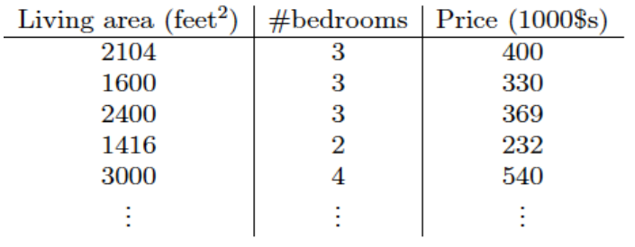
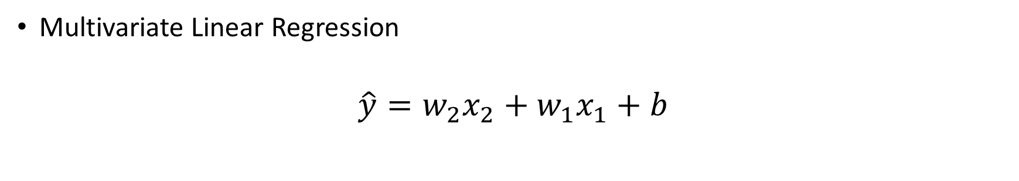
Multiple input features
Multivariate Linear Regression
$$\hat{y}=w_{2}x_{2}+w_{1}x_{1}+b$$

Slide 6
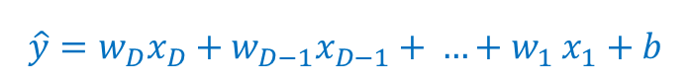
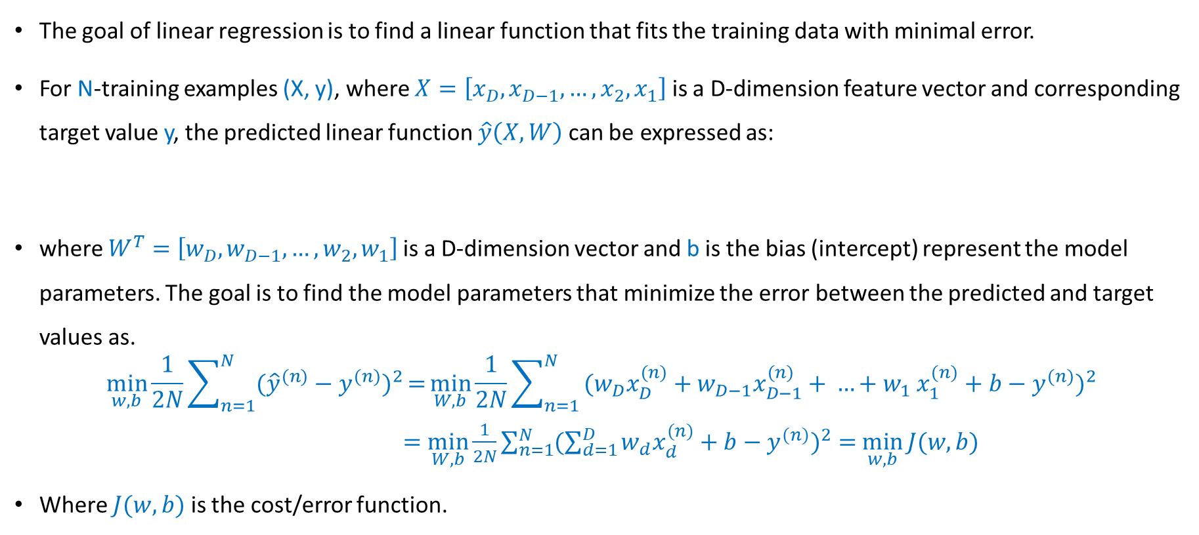
Ordinary Linear Regression
The goal of linear regression is to find a linear function that fits the training data with minimal error.
For N-training examples (X, y), where $X=\left[{x_{D},x}_{D−1}, …,x_{2},x_{1}\right]$ is a D-dimension feature vector and corresponding target value y, the predicted linear function $\hat{y}\left(X,W\right)$can be expressed as:
where $W^{T}=$ $\left[{w_{D},w}_{D−1}, …,w_{2},w_{1}\right]$is a D-dimension vector and b is the bias (intercept) represent the model parameters. The goal is to find the model parameters that minimize the error between the predicted and target values as.
$$\min_{w,b}{\frac{1}{2N}\sum_{n=1}^{N}{\text{(}{\hat{y}}^{(n)}−y^{(n)}})^{2}}={\min_{W,b}{\frac{1}{2N}\sum_{n=1}^{N}{\text{(}w_{D}x_{D}^{(n)}+w_{D−1}x_{D−1}^{(n)}{+ …+w}_{1}x_{1}^{(n)}+b−y^{(n)}})^{2}}}$$
$=$ $\min_{W,b}{\frac{1}{2N}\sum_{n=1}^{N}{(\sum_{d=1}^{D}{w_{d}x_{d}^{(n)}}+b−y^{(n)}})^{2}=}$ $\min_{w,b}{J(w,b)}$
Where $J(w,b)$ is the cost/error function.
$$\hat{y}=w_{D}x_{D}+w_{D−1}x_{D−1}{+ …+w}_{1}x_{1}+b$$

Slide 7
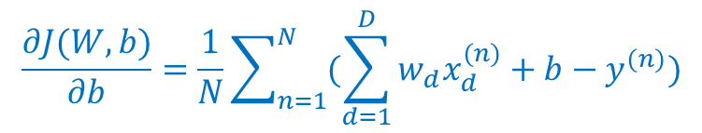
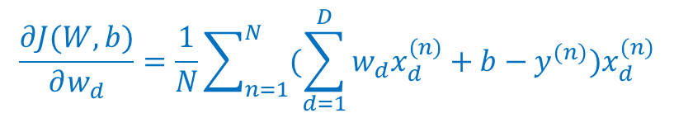
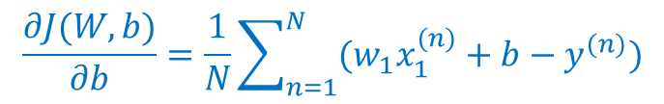
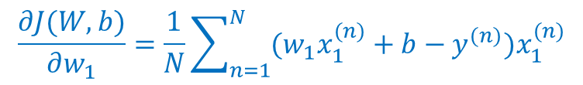
Ordinary Linear Regression
To solve the optimization problem, we need to define gradient of J(w , b) with respect to w and b as:
$$\frac{∂J(W,b)}{∂w_{d}}=\frac{1}{N}\sum_{n=1}^{N}{(\sum_{d=1}^{D}{w_{d}x_{d}^{(n)}}+b−y^{(n)}})x_{d}^{(n)}$$
$$\frac{∂J(W,b)}{∂b}=\frac{1}{N}\sum_{n=1}^{N}{(\sum_{d=1}^{D}{w_{d}x_{d}^{(n)}}+b−y^{(n)}})$$
for one dimensional case, D = 1, (i.e. a line) we have:
$$\frac{∂J(W,b)}{∂w_{1}}=\frac{1}{N}\sum_{n=1}^{N}{(w_{1}x_{1}^{(n)}+b−y^{(n)}})x_{1}^{(n)}$$
$$\frac{∂J(W,b)}{∂b}=\frac{1}{N}\sum_{n=1}^{N}{(w_{1}x_{1}^{(n)}+b−y^{(n)}})$$

Slide 8
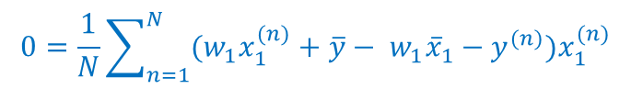
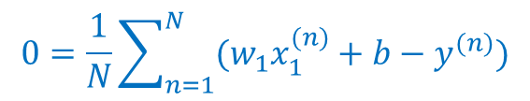
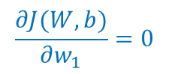
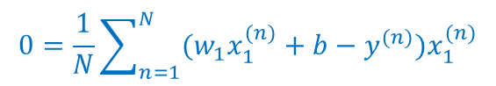
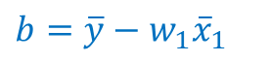
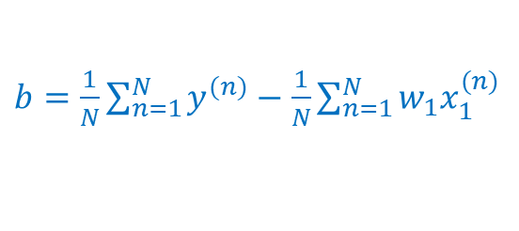
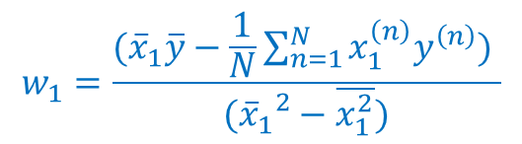
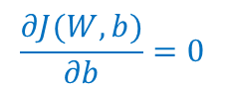
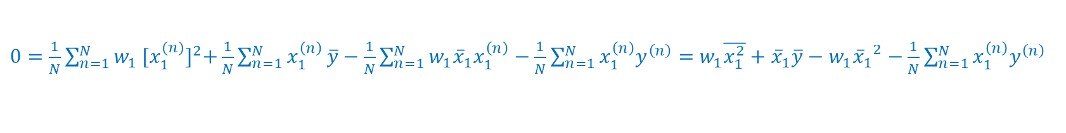
Closed form Solution
In closed form, we can find the solution for the 1-d case when
$$\frac{∂J(W,b)}{∂b}=0$$
as:
$$0=\frac{1}{N}\sum_{n=1}^{N}{(w_{1}x_{1}^{(n)}+b−y^{(n)}})$$
$b=\frac{1}{N}\sum_{n=1}^{N}{y^{(n)}}−$ $\frac{1}{N}\sum_{n=1}^{N}{w_{1}x_{1}^{(n)}}$
$b=\overline{y}−$ $w_{1}{\overline{x}}_{1}$
and
$$\frac{∂J(W,b)}{∂w_{1}}=0$$
$$0=\frac{1}{N}\sum_{n=1}^{N}{(w_{1}x_{1}^{(n)}+b−y^{(n)}})x_{1}^{(n)}$$
$$0=\frac{1}{N}\sum_{n=1}^{N}{(w_{1}x_{1}^{(n)}+\overline{y}− w_{1}{\overline{x}}_{1}−y^{(n)}})x_{1}^{(n)}$$
$0=\frac{1}{N}\sum_{n=1}^{N}{w_{1}}{[x_{1}^{(n)}]}^{2}+\frac{1}{N}\sum_{n=1}^{N}{x_{1}^{\left(n\right)}}\overline{y}−\frac{1}{N}\sum_{n=1}^{N}{{w_{1}{\overline{x}}_{1}x}_{1}^{\left(n\right)}}−\frac{1}{N}\sum_{n=1}^{N}{{x_{1}^{\left(n\right)}y}^{\left(n\right)}}=$ $w_{1}\overline{x_{1}^{2}}+{\overline{x}}_{1}\overline{y}−w_{1}{{\overline{x}}_{1}}^{2}−\frac{1}{N}\sum_{n=1}^{N}{{x_{1}^{\left(n\right)}y}^{\left(n\right)}}$
$$w_{1}=\frac{({\overline{x}}_{1}\overline{y}−\frac{1}{N}\sum_{n=1}^{N}{{x_{1}^{\left(n\right)}y}^{\left(n\right)}) }}{({{\overline{x}}_{1}}^{2}−\overline{x_{1}^{2}})}$$

Slide 9
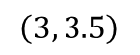
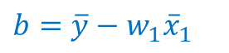
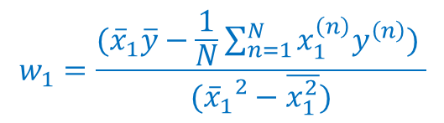
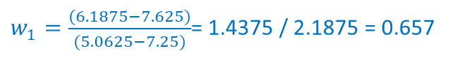
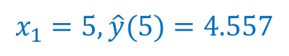
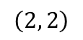

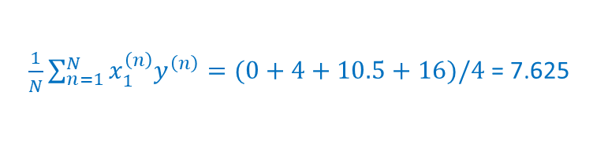
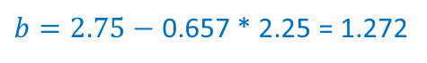
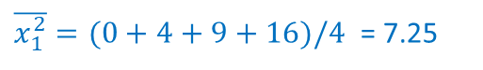
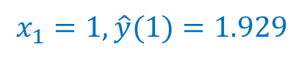
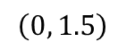
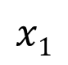
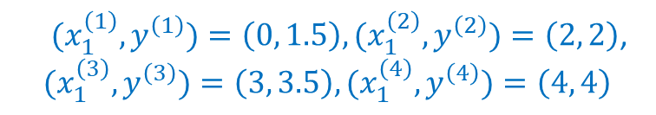
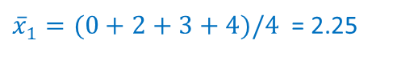
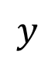
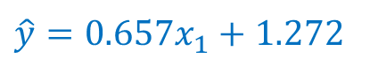
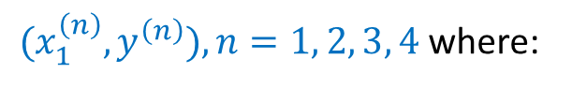
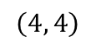
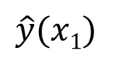
Example
For input data
${{(x}_{1}^{\left(n\right)}, y}^{\left(n\right)}), n=1, 2, 3, 4$where:
${{(x}_{1}^{\left(1\right)}, y}^{\left(1\right)})=\left(0, 1.5\right), {{(x}_{1}^{\left(2\right)}, y}^{\left(2\right)})=\left(2, 2\right)$,
$${{(x}_{1}^{\left(3\right)}, y}^{\left(3\right)})=\left(3, 3.5\right), {{(x}_{1}^{\left(4\right)}, y}^{\left(4\right)})=\left(4, 4\right)$$
$$\hat{y}(x1)$$
$$y$$
$$\left(4, 4\right)$$
Find the line $\hat{y}=w_{1}x_{1}+b$ that best-fit the above data
$$\left(3, 3.5\right)$$
$$w_{1}=\frac{({\overline{x}}_{1}\overline{y}−\frac{1}{N}\sum_{n=1}^{N}{{x_{1}^{\left(n\right)}y}^{\left(n\right)}) }}{({{\overline{x}}_{1}}^{2}−\overline{x_{1}^{2}})}$$
$b=\overline{y}−$ $w_{1}{\overline{x}}_{1}$
$$\left(2, 2\right)$$
$$\left(0, 1.5\right)$$
$$x1$$
${\overline{x}}_{1}=(0+2+3+4)/4$ = 2.25
$\overline{y}=(1.5+2+3.5+4)/4$ = 2.75
0
1
2
3
4
$\overline{x_{1}^{2}}=(0+4+9+16)/4$ = 7.25
$\frac{1}{N}\sum_{n=1}^{N}{{x_{1}^{\left(n\right)}y}^{\left(n\right)}=(0+4+10.5+16)/4}$ = 7.625
Predictions:
$w_{1}=\frac{(6.1875−7.625)}{(5.0625−7.25)}$= 1.4375 / 2.1875 = 0.657
$b=2.75−$ 0.657 * 2.25 = 1.272
$$x_{1}=1, \hat{y}(1)=1.929$$
$\hat{y}=0.657x_{1}+1.272$
$$x_{1}=5, \hat{y}(5)=4.557$$

Slide 10

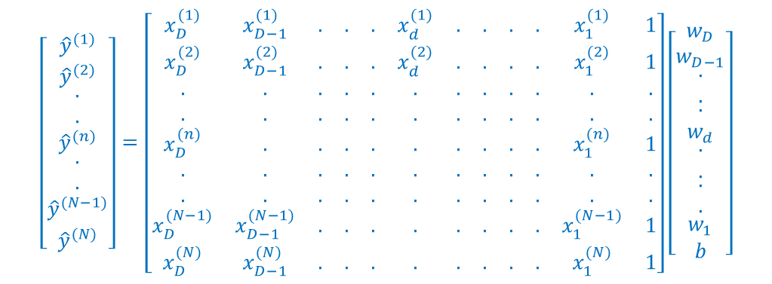
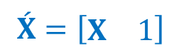

Normal Equations
We can write the training examples ($X^{(n)}$, $y^{(n)}$) as a set of N linear equations with unknowns W and b. For example n, the equation can be written as:
$${\hat{y}}^{(n)}= w_{D}x_{D}^{(n)}+w_{D−1}x_{D−1}^{(n)}{+ …+w}_{1}x_{1}^{(n)}+b$$
Or in a matrix form: $\hat{Y}$ = $\acute{X}\acute{W}$
where
$$\acute{X}=\left[\begin{matrix}X & 1\end{matrix}\right]$$
$\acute{W}=$ $\left[\begin{matrix}W \\ b\end{matrix}\right]$
$$\left[\begin{matrix}{\hat{y}}^{(1)} \\ {\hat{y}}^{(2)} \\ \begin{matrix}. \\ . \\ \begin{matrix}{\hat{y}}^{(n)} \\ \begin{matrix}. \\ . \\ \begin{matrix}{\hat{y}}^{(N−1)} \\ {\hat{y}}^{(N)}\end{matrix}\end{matrix}\end{matrix}\end{matrix}\end{matrix}\right]=\left[\begin{matrix}x_{D}^{(1)} & x_{D−1}^{(1)} & . & . & . & x_{d}^{(1)} & . & . & . & . & x_{1}^{(1)} & 1 \\ x_{D}^{(2)} & x_{D−1}^{(2)} & . & . & . & x_{d}^{(2)} & . & . & . & . & x_{1}^{(2)} & 1 \\ . & . & . & . & . & . & . & . & . & . & . & . \\ . & . & . & . & . & . & . & . & . & . & . & . \\ x_{D}^{(n)} & . & . & . & . & . & . & . & . & . & x_{1}^{(n)} & 1 \\ . & . & . & . & . & . & . & . & . & . & . & . \\ . & . & . & . & . & . & . & . & . & . & . & . \\ x_{D}^{(N−1)} & x_{D−1}^{(N−1)} & . & . & . & . & . & . & . & . & x_{1}^{(N−1)} & 1 \\ x_{D}^{(N)} & x_{D−1}^{(N)} & . & . & . & . & . & . & . & . & x_{1}^{(N)} & 1\end{matrix}\right]\left[\begin{matrix}w_{D} \\ w_{D−1} \\ \begin{matrix}. \\ . \\ \begin{matrix}. \\ w_{d} \\ \begin{matrix}. \\ . \\ \begin{matrix}\begin{matrix}. \\ .\end{matrix} \\ w_{1} \\ b\end{matrix}\end{matrix}\end{matrix}\end{matrix}\end{matrix}\right]$$

Slide 11
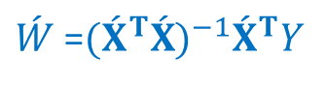
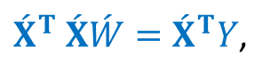
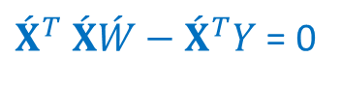
Normal Equations
We can minimize:
$J\left(\acute{W}\right)={\frac{1}{2}\left(Y−\hat{Y}\right)}^{T}(Y−\hat{Y })={\frac{1}{2}\left(Y−\acute{X}\acute{W}\right)}^{T}(Y−\acute{X}\acute{W})$
By taking the first derivative of $J\left(\acute{W}\right)$ With respect to $\acute{W}$ as:
${{\acute{X}}^{T} \acute{X}\acute{W}−\acute{X}}^{T}Y$ = 0
Or
${\acute{X}}^{T} \acute{X}\acute{W}={\acute{X}}^{T}Y$,
then,
$\acute{W}$ =${({\acute{X}}^{T}\acute{X})}^{−1}{\acute{X}}^{T}Y$

Slide 12
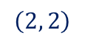
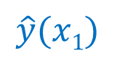
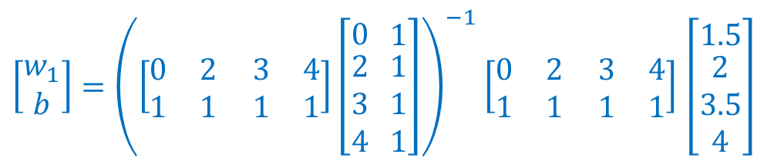
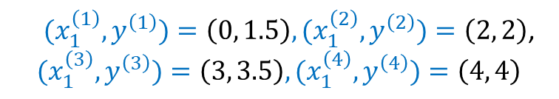
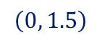
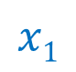







Example
For input data
${{(x}_{1}^{\left(n\right)}, y}^{\left(n\right)}), n=1, 2, 3, 4$where:
$$\hat{y}(x1)$$
${{(x}_{1}^{\left(1\right)}, y}^{\left(1\right)})=\left(0, 1.5\right), {{(x}_{1}^{\left(2\right)}, y}^{\left(2\right)})=\left(2, 2\right)$,
$${{(x}_{1}^{\left(3\right)}, y}^{\left(3\right)})=\left(3, 3.5\right), {{(x}_{1}^{\left(4\right)}, y}^{\left(4\right)})=\left(4, 4\right)$$
$$y$$
$$\left(4, 4\right)$$
So,
$$\left(3, 3.5\right)$$
Y = $\left[\begin{matrix}1.5 \\ \begin{matrix}2 \\ 3.5 \\ 4\end{matrix}\end{matrix}\right]$
$$\acute{X}=\left[\begin{matrix}0 \\ \begin{matrix}2 \\ 3 \\ 4\end{matrix}\end{matrix}\begin{matrix} 1 \\ \begin{matrix} 1 \\ 1 \\ 1\end{matrix}\end{matrix}\right]$$
$$\acute{W}=\left[\begin{matrix}w_{1} \\ b\end{matrix}\right]$$
$$\left(2, 2\right)$$
$$\left(0, 1.5\right)$$
$$x1$$
Since,
$\acute{W}$ =${({\acute{X}}^{T}\acute{X})}^{−1}{\acute{X}}^{T}Y$
0
1
2
3
4
Then,
$\left[\begin{matrix}w_{1} \\ b\end{matrix}\right]={\left(\left[\begin{matrix}0 & 2 \\ 1 & 1\end{matrix} \begin{matrix}3 & 4 \\ 1 & 1\end{matrix}\right]\left[\begin{matrix}0 \\ \begin{matrix}2 \\ 3 \\ 4\end{matrix}\end{matrix}\begin{matrix} 1 \\ \begin{matrix} 1 \\ 1 \\ 1\end{matrix}\end{matrix}\right]\right)}^{−1}$ $\left[\begin{matrix}0 & 2 \\ 1 & 1\end{matrix} \begin{matrix}3 & 4 \\ 1 & 1\end{matrix}\right]$ $\left[\begin{matrix}1.5 \\ \begin{matrix}2 \\ 3.5 \\ 4\end{matrix}\end{matrix}\right]$

Slide 13





Example
$\left[\begin{matrix}w_{1} \\ b\end{matrix}\right]={\left(\left[\begin{matrix}0 & 2 \\ 1 & 1\end{matrix} \begin{matrix}3 & 4 \\ 1 & 1\end{matrix}\right]\left[\begin{matrix}0 \\ \begin{matrix}2 \\ 3 \\ 4\end{matrix}\end{matrix}\begin{matrix} 1 \\ \begin{matrix} 1 \\ 1 \\ 1\end{matrix}\end{matrix}\right]\right)}^{−1}$ $\left[\begin{matrix}0 & 2 \\ 1 & 1\end{matrix} \begin{matrix}3 & 4 \\ 1 & 1\end{matrix}\right]$ $\left[\begin{matrix}1.5 \\ \begin{matrix}2 \\ 3.5 \\ 4\end{matrix}\end{matrix}\right]$
Which can be coded as:
$$\hat{y}(x1)$$
$$x1$$

Slide 14



Gradient Based Optimization
We usually use optimization techniques to minimize an objective function J(x). To maximize the same function you can minimize –J(x) instead.
The first derivative of a function J(x) is denoted as $J^{′}\left(x\right)= \frac{dJ(x)}{dx}$
The gradient can be approximated as $J^{′}\left(x\right)≈ \frac{J\left(x + ∈\right) − J(x)}{∈}$, where $∈$ is a small change in the input.
The information we get from the gradient can help us to minimize a function (to find values of the input where the function attains minimum value(s)).
J(x)= 0.5x²
$J^{′}\left(x\right)$ = x
$J^{′}\left(x\right)$<0
$J^{′}\left(x\right)$>0
x
0

Slide 15





Gradient Based Optimization
gradient descent technique uses the first derivative iteratively as:
$x^{(t+1)}=x^{(t)}−{αJ}^{′}\left(x\right)$
(where $α$ is learning rate; a small positive number to control the rate of updating the optimized parameters)
If we start with x^{(t)} < 0, the slope (first derivative $J^{′}\left(x\right)$) is negative, then - $J^{′}\left(x\right)$ is positive, then x^{(t+1)} is moving to the right toward the minimum (x = 0)
If we start with x^{(t)} > 0, the slope is positive, then - $J^{′}\left(x\right)$ is negative, then x^{(t+1)} is moving to the left toward the minimum (x = 0)
If $J^{′}\left(x\right)$ = 0, the no change since we are already reached to the minimum
J(x)= 0.5x²
$J^{′}\left(x\right)$ = x
$J^{′}\left(x\right)$<0
$J^{′}\left(x\right)$>0
x
0

Slide 16

Visualization
Source: https://www.youtube.com/watch?v=kJgx2RcJKZY

Slide 17




Gradient Descent for Linear Regression
Using the partial derivatives of the cost function with respect to W and b as:
$$\frac{∂J(W,b)}{∂w_{d}}=\frac{1}{N}\sum_{n=1}^{N}{(\sum_{d=1}^{D}{w_{d}x_{d}^{(n)}}+b−y^{(n)}})x_{d}^{(n)}$$
$$\frac{∂J(W,b)}{∂b}=\frac{1}{N}\sum_{n=1}^{N}{(\sum_{d=1}^{D}{w_{d}x_{d}^{(n)}}+b−y^{(n)}})$$
And by initializing W and b with random values, or zeros, then we can update the W and b at each iteration t update equation as to get new values as:
$w_{d}^{[t+1]}=w_{d}^{[t]}−α$ $\frac{∂J(W,b)}{∂w_{d}}$
$b^{[t+1]}=b^{[t]}−α$ $\frac{∂J(W,b)}{∂b}$
Where $α$ is the learning rate of the gradient descent approach. Large values for $α$ can cause the algorithm to diverge, while very small values can cause slower convergence.
The algorithm converges when there is no significant changes in $J(W,b)$in consecutive iterations.

Slide 18














Example
For input data
${{(x}_{1}^{\left(n\right)}, y}^{\left(n\right)}), n=1, 2, 3, 4$where:
${{(x}_{1}^{\left(1\right)}, y}^{\left(1\right)})=\left(0, 1.5\right), {{(x}_{1}^{\left(2\right)}, y}^{\left(2\right)})=\left(2, 2\right)$,
$${{(x}_{1}^{\left(3\right)}, y}^{\left(3\right)})=\left(3, 3.5\right), {{(x}_{1}^{\left(4\right)}, y}^{\left(4\right)})=\left(4, 4\right)$$
$$\frac{∂J(W,b)}{∂w_{1}}=\frac{1}{N}\sum_{n=1}^{N}{(w_{1}x_{1}^{(n)}+b−y^{(n)}})x_{1}^{(n)}$$
$$w_{1}^{[0]}=0, b^{[0]}=0, α=0.1$$
$$\frac{∂J(W,b)}{∂b}=\frac{1}{N}\sum_{n=1}^{N}{(w_{1}x_{1}^{(n)}+b−y^{(n)}})$$
$\frac{∂J(W,b)}{∂w_{1}}=\frac{1}{4}\left(−0∗1.5−2∗2−3∗3.5−4∗4\right)$=-7.625
$w_{i}^{[t+1]}=w_{1}^{[t]}−α$ $\frac{∂J(W,b)}{∂w_{1}}$
$$\frac{∂J(W,b)}{∂b}=\frac{1}{4}\left(−1.5−2−3.5−4\right)\text{=}\text{−2.75}$$
$b^{[t+1]}=b^{[t]}−α$ $\frac{∂J(W,b)}{∂b}$
$$w_{1}^{[1]}=0 −0.1∗−7.625=0.7625$$
$$b^{[1]}=0.275$$
$\frac{∂J(W,b)}{∂w_{1}}=\frac{1}{4}\left(\begin{aligned}\left(0.7625∗0+0.275−1.5\right)∗0+ \\ \left(0.7625∗2+0.275−2\right)∗2+ \\ \left(0.7625∗3+0.275−3.5\right)∗3+ \\ \left(0.7625∗4+0.275−4\right)∗4\end{aligned}\right)$=-1.48
$\frac{∂J(W,b)}{∂b}=\frac{1}{4}\left(\begin{aligned}\left(0.7625∗0+0.275−1.5\right)+ \\ \left(0.7625∗2+0.275−2\right)+ \\ \left(0.7625∗3+0.275−3.5\right)+ \\ \left(0.7625∗4+0.275−4\right)\end{aligned}\right)$=--0.76
$$w_{1}^{[2]}=0. 7625−0.1∗−1.48=0.91$$
$$b^{[2]}=0.351$$
then after 200 iterations you get
$w_{1}^{[200]}=$ 0.65833175
$$b^{[200]}=\text{1.267742610841535}$$

Slide 19

Example

Slide 20


Effect of the learning rate on convergence
alpha = 0. 1
We obtained a good solution with small error

Slide 21


Effect of the learning rate on convergence
alpha = 0.001
alpha = 0.01
Very small alpha, very slow convergence
small alpha, slow convergence

Slide 22

Effect of the learning rate on convergence
alpha = 0. 1
alpha = 0.2
A little larger alpha, faster convergence with some oscillations
Reasonable alpha, better convergence

Slide 23



Effect of the learning rate on convergence
alpha = 0. 25
alpha = 0.3
Larger alpha, higher oscillations, but it converges
Very large alpha, diverges and can cause overflow

Slide 24
Normal Equations versus Gradient Descent
Normal Equations | Gradient descent
+ Non-iterative | - Iterative and depends on the initial guess
- Needs matrix inversion Computationally expensive for large matrices (size >1000 x 1000) Some matrices are not invertible in some cases such as features are not independent | + No matrix inversion, computationally attractive
+ No controlling Parameters | - Convergence is affected by the value of the learning rate
+ No need for stopping criterion | - Needs stopping criterion, affects the convergence
- Is not extendable to other machine learning approaches | + Can be extended to other machines learning approaches and it is a commonly used approach

Slide 25
scikit-learn linear_model.LinearRegression()
Use linear_model.LinearRegression() to initialize an instance of the linear model with parameters:
fit_intercept : bool, default=True
If True, find the intercept, bias term, b of the line. Otherwise, data assumed to be centered (i.e. b = 0)
Attribute coef_
Returns the estimated coefficients W
Attribute intercept_
Returns the estimated intercept b
For more description and examples: https://scikit-learn.org/stable/modules/generated/sklearn.linear_model.LinearRegression.html

Slide 26

scikit-learn linear_model.LinearRegression()
Method fit(X_train, Y_train)
finds the linear model
Method predict(X_test)
Use the model to predict the output values
Method Score(Y_test, Y_pridect)
Returns the coefficient of determination R² score as:
$$R^{2}=1−\frac{\sum{{(y−\hat{y})}^{2}}}{\sum{{(y−\overline{y})}^{2}}}$$
best value is 1 when $y=\hat{y}$, and it is zero when the model always predict $\hat{y}$ as $\overline{y}$regardless of the input. It assesses the goodness of fit of a linear regression model. It quantifies the proportion of the variance in the dependent variable (the variable you're trying to predict) that is explained by the independent variable(s) in the model.

Slide 27


Code

Slide 28
Thank You!

